Slide 1

SERVICE PRO
PRESENTED BY:
Sajit Gurung
Nabin Adhikari
Ankit Poudyal

Slide 2
INTRODUCTION
"Service Pro" is a service provider app designed to streamline service delivery.
Seamlessly connects qualified service providers with users, enabling effortlessly selecting of service needs, reviewing provider profiles, and booking appointments.
The Provider Application allows providers to apply for user-selected service opportunities, ensuring a seamless match between skills and user requirements, while the User Application empowers users to effortlessly describe their service needs and connect with qualified providers.

Slide 3
PROBLEM STATEMENT
Traditional methods of service delivery often lack efficiency and transparency, leading to frustration and inefficiencies in the service industry. Manual systems are prone to errors, resulting in missed opportunities and unsatisfied customers.
Service providers currently face difficulties in finding relevant service opportunities and connecting with users who require their services. Likewise, users struggle to find qualified service providers for their specific needs and often resort to unreliable methods of sourcing services.

Slide 4
OBJECTIVES
To implement a secure and efficient communication system between service providers and users to facilitate service bookings.
To enable users to seamlessly book services from the comfort of their homes, ensuring efficient and convenient service access.

Slide 5
METHODOLOGY
We've decided to choose the Spiral Model for developing the "Service Pro" service provider and user apps due to its iterative and flexible nature.
The Spiral Model facilitates iterative development, refining the "Service Pro" apps based on user feedback and evolving requirements, while prioritizing risk management for sensitive service provision and user data handling by analyzing and mitigating potential risks at each iteration.

Slide 6
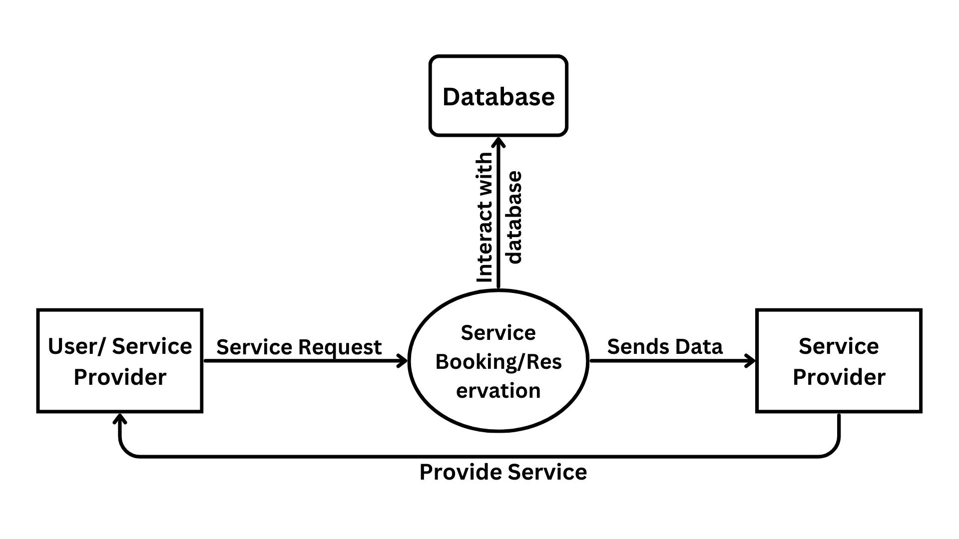
CONTEXT LEVEL DFD

Slide 7
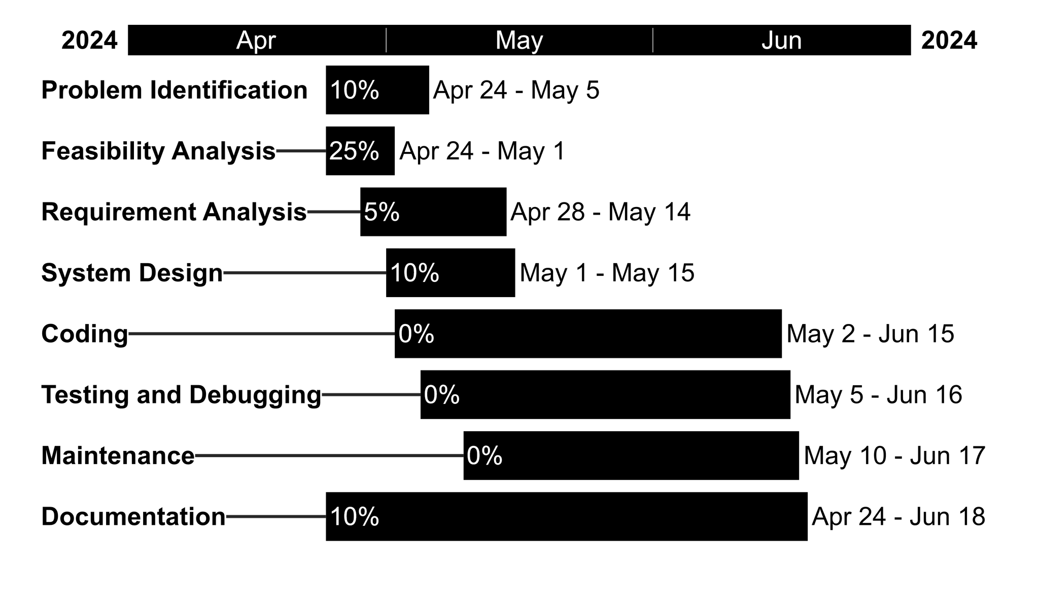
GANTT CHART

Slide 8
DELIVERABLES
Develop a user-friendly system enabling seamless service booking for users.
Implement a feature facilitating direct communication between users and service providers within the app, enhancing efficiency in addressing service-related inquiries and concerns.
Create a platform for users and providers to manage their profiles.

Slide 9
CONCLUSION
1.Service Pro represents a significant advancement in service provision, aiming to enhance the user experience through an innovative platform.
2.Intuitive interfaces and seamless communication channels empower service providers and users, fostering collaboration and mutual benefit.
3.Through efficiency, clarity, and coordination, "Service Pro" aims to set new standards for excellence and innovation in the service industry.

